Slide 1
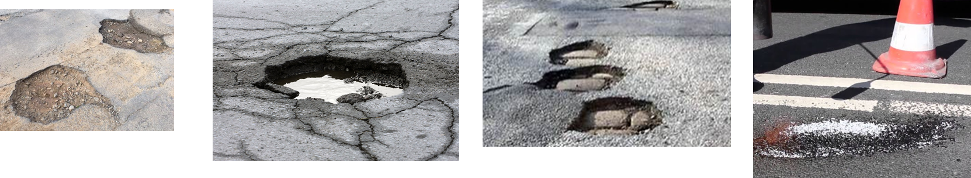
IPD346 Data Science for Business Final Project Chicago Pothole Data Analysis
Hung Lee
May 30, 2019

Slide 2
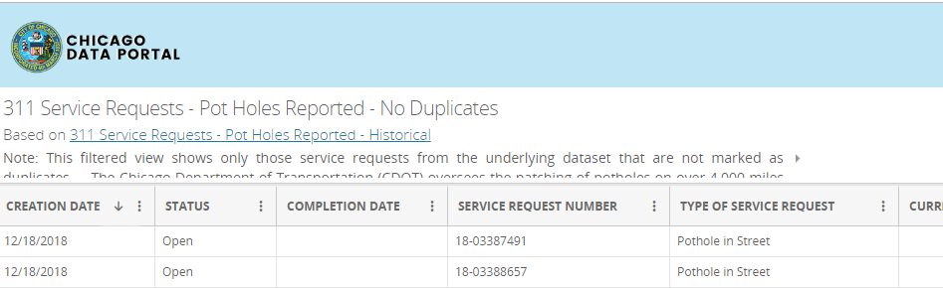
Overview
In this package, the service request data related to potholes is analyzed
In Chicago Data Portal, under “Service Requests”, one may find the data about various service requests, including requests to repair potholes.
The specific data used in this project is at https://data.cityofchicago.org/Service-Requests/311-Service-Requests-Pot-Holes-Reported-No-Duplica/bp3e-nw4d
The ultimate goal of this project is to apply what we’ve learned in this class on a real dataset that is relevant to our every day life.

Slide 3

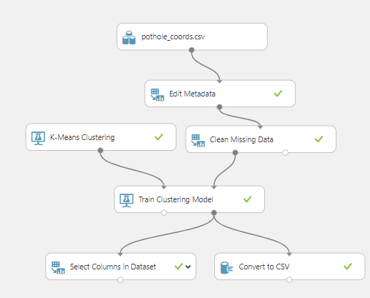


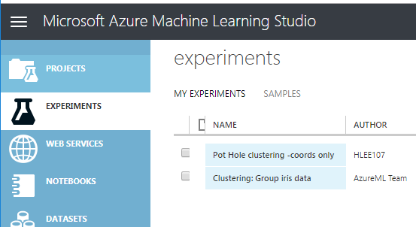
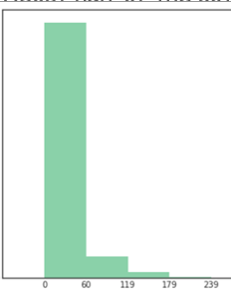
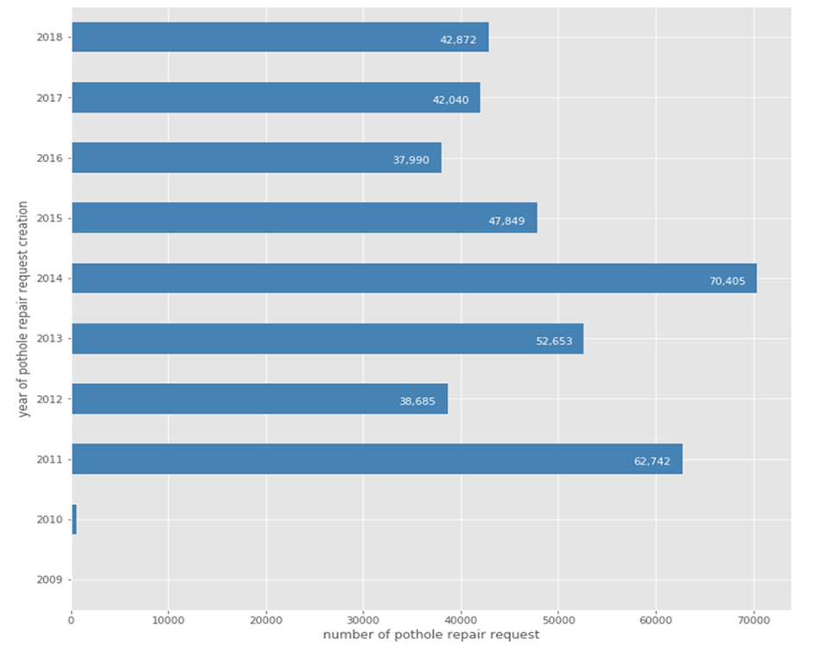
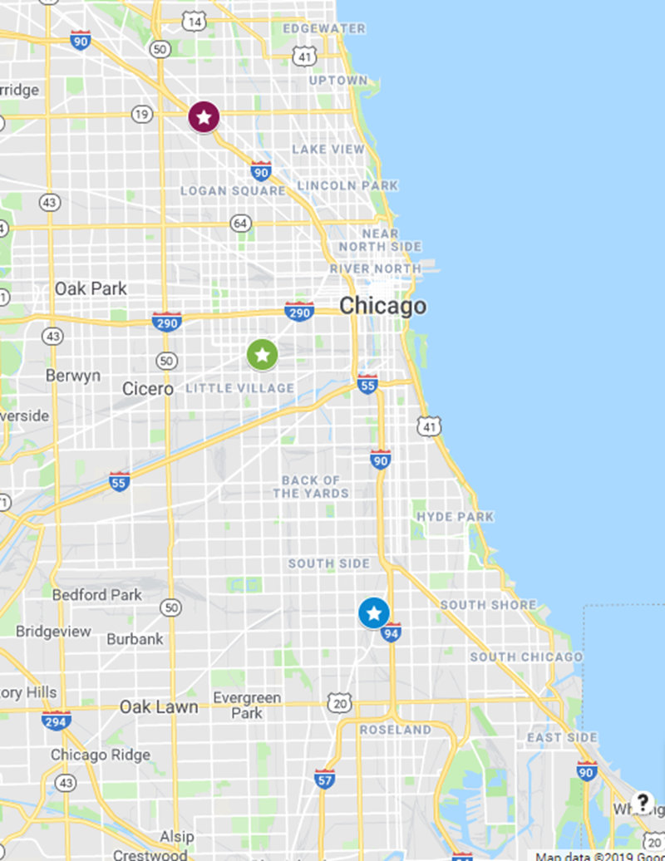



Process & Data Flow
Machine Learning w/ Clustering
Data selection
Ask Questions
Report Findings
Preliminary analysis
Data Transformation
Data Analysis & Visualization

Slide 4
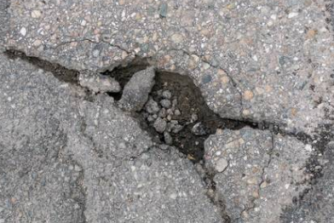
Small Questions, Big Questions…
Talking about potholes – what would come to your mind?
How many are there? 10’s? 100’s? 1000s?
When do they typically occur?
Where are they located?
Are there streets more prone to potholes?
How quickly are they fixed?
And more questions if we know the answers to the above -
What are the $$ spent each year fixing the pot holes?
What are the impact of the pot holes to Chicagoans? (e.g., traffic congestions, air pollution, noises, etc.)
Does CDOT operate effectively repairing the potholes?
If certain locations are prone to potholes, why? (assuming the weather factor is the same to all locations)
Are there ways to predict and prevent future potholes?

Slide 5
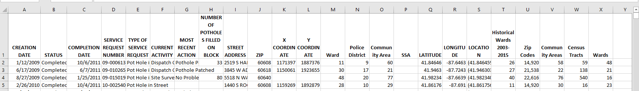
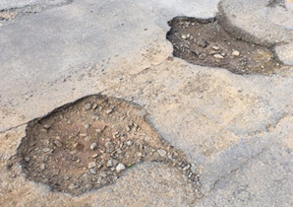

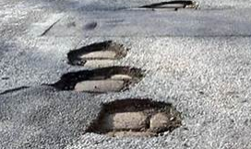
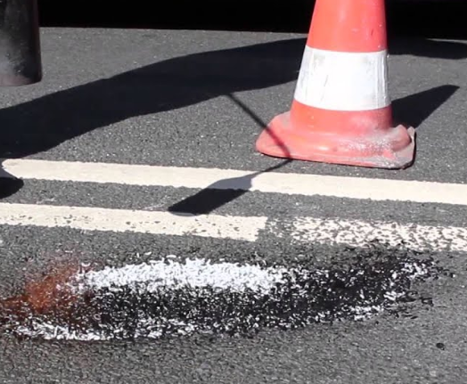
Original Dataset
The original table had 19 columns looks like this:
There are395,790 records in the file

Slide 6
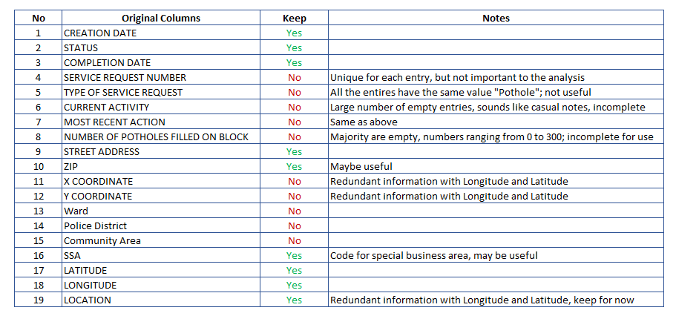
Data selection & preparation
The original dataset is examined and columns that are not useful are removed
Columns with lots of empty cells, with redundant information, or with uncertain information are removed…

Slide 7
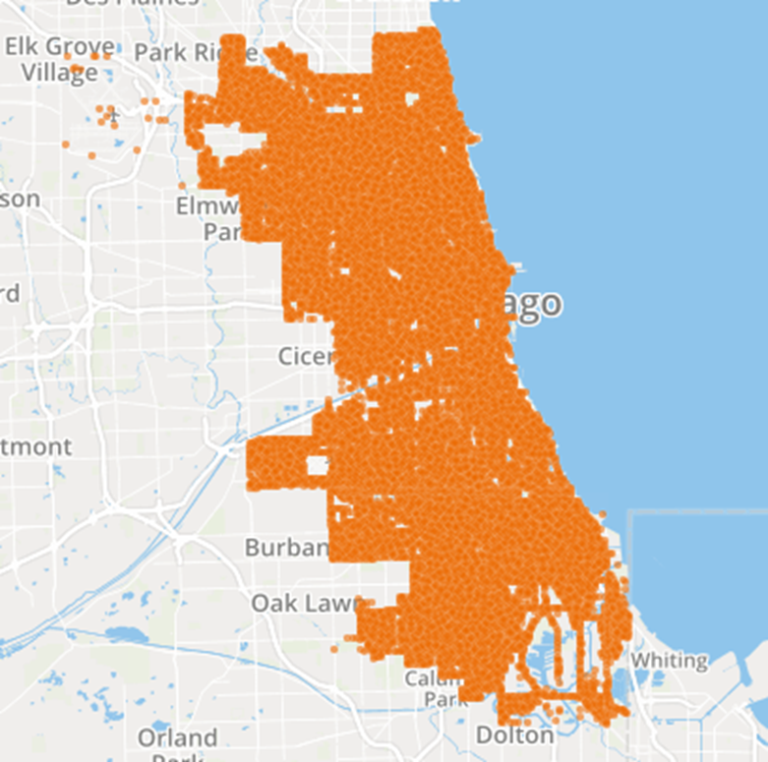
Where are the potholes?
They are everywhere!
The dataset has 395,790 entries and 204,635 unique locations with requests created between 2009 and 2018
On the right is the map plotted using the location data in the pothole dataset, available also in the Chicago data portal: https://data.cityofchicago.org/Service-Requests/311-Service-Requests-Pot-Holes-Reported-Map/xfzx-rx2y

Slide 8
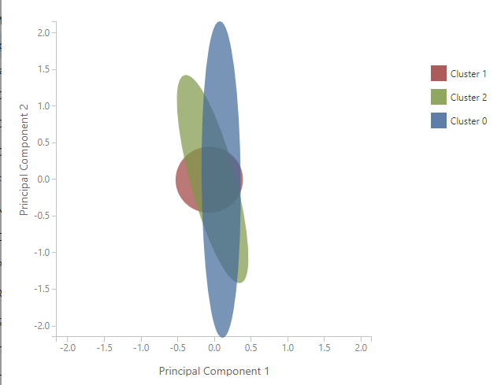
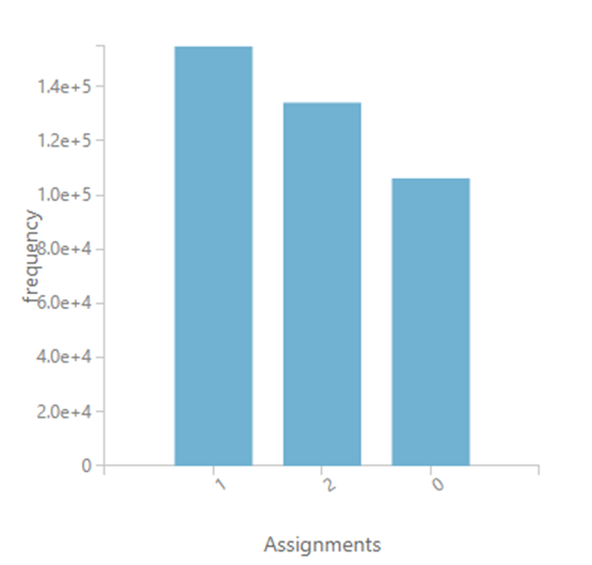
Clusters of pothole locations?
The coordinates of the pothole locations are fed into Microsoft Azure ML studio to see if they are centered around certain locations in Chicago – I used 3 centroids for this experiment:
Cluster 1 has more spots closely co-located than the other two clusters

Slide 9

Seeing 3 circles on the map
Plotting the centroids on the map:
it seems more potholes are collocated in the smallest circle on the top, along the highway; the other two circles are larger, but less dense
The areas covered are fairly consistent with the previous map but with slightly more information

Slide 10

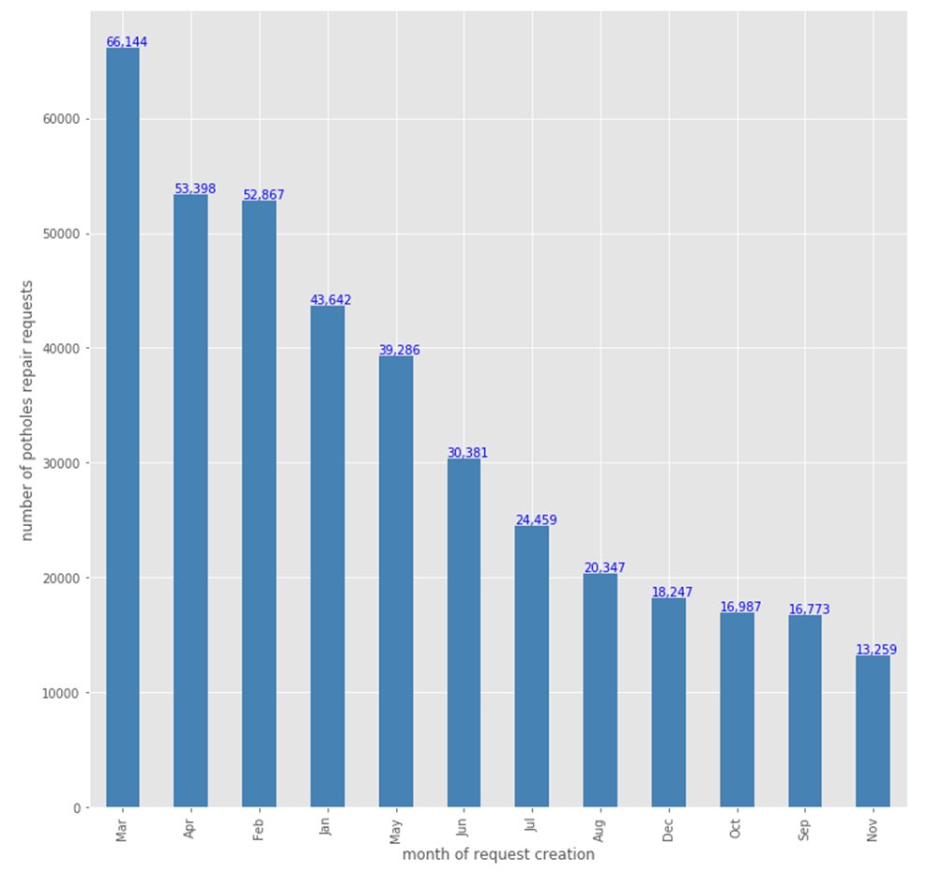
Are potholes related to the weather?
Definitely! Winter 2013-2014 was very bad, and March has the most service requests!

Slide 11
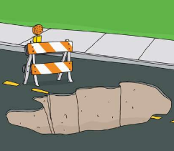
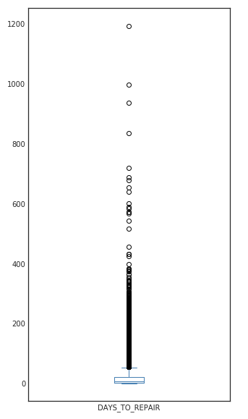
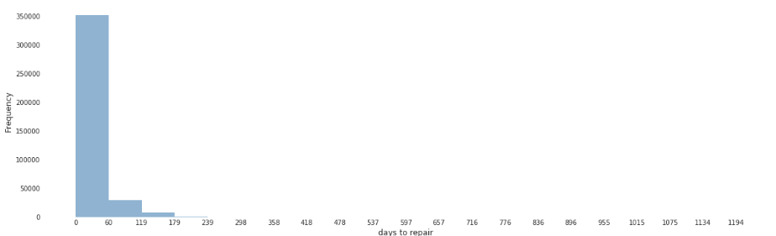
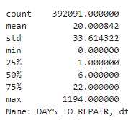
How soon are potholes repaired?
About half of the potholes were repaired within 6 days after the service requests were opened. Some were fixed on the same day. The average is 20 days. However there are many outliers, and there is a pothole that’s left there for over 3 years before being repaired!

Slide 12

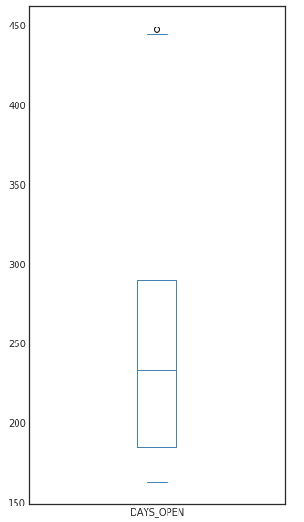
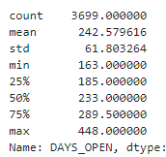
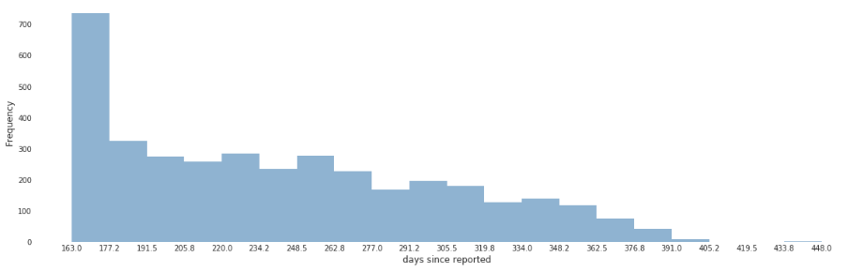
How about those that are still there?
There are 3699 (~1%) potholes yet to be fixed according to the data.
It seems these open ones have an average lifetime of 242 days! It is inconsistent with the average fixing days of 20.
Is it because the data is not updated properly? Is it because these are places very difficult to fix? Is it because….?

Slide 13
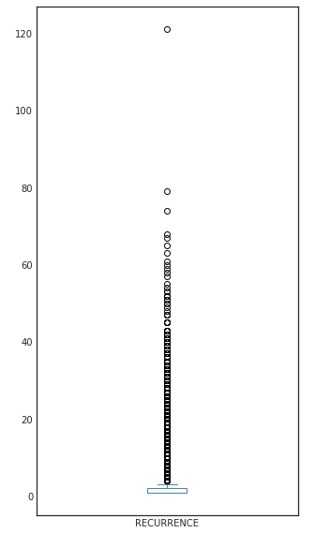
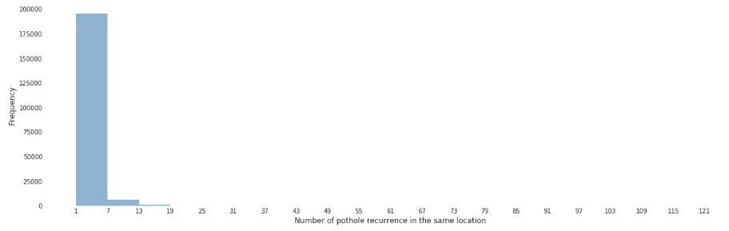
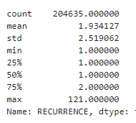
Repeated requests in the same location?
Majority of the locations has 1 or 2 service requests over the past 10 years. However, a fraction of the locations had up to 121 recurrences!
3468 locations had more than 6 service requests; 517 locations had over 20 requests; 127 locations had over 30 requests; 21 locations had more than 50 requests;
1 location had 121 service requests!
;

Slide 14
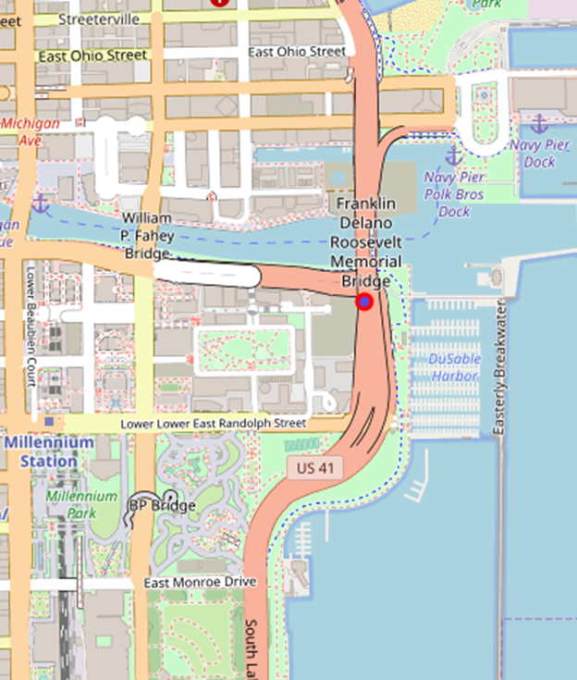
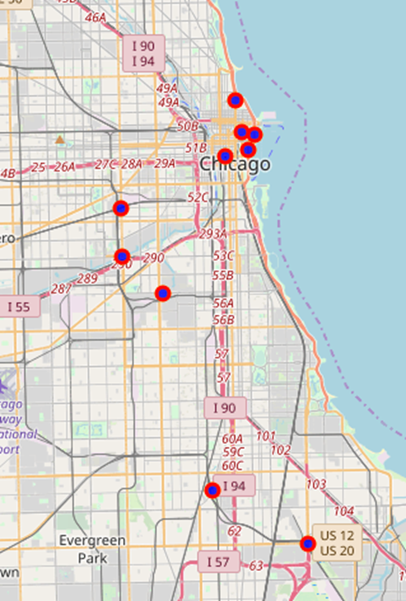
THE top one and top 10 locations

Slide 15
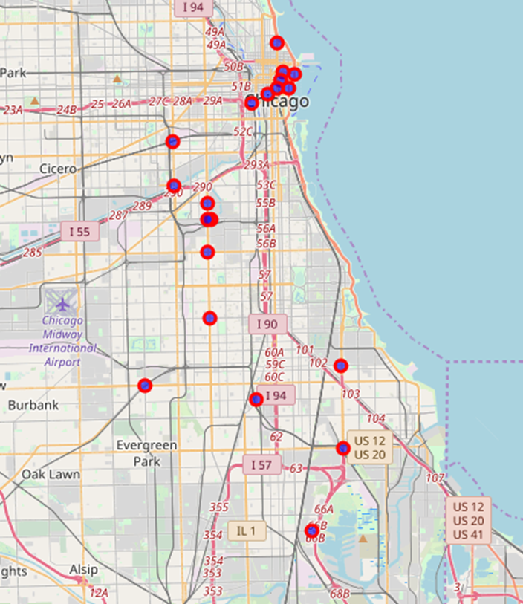
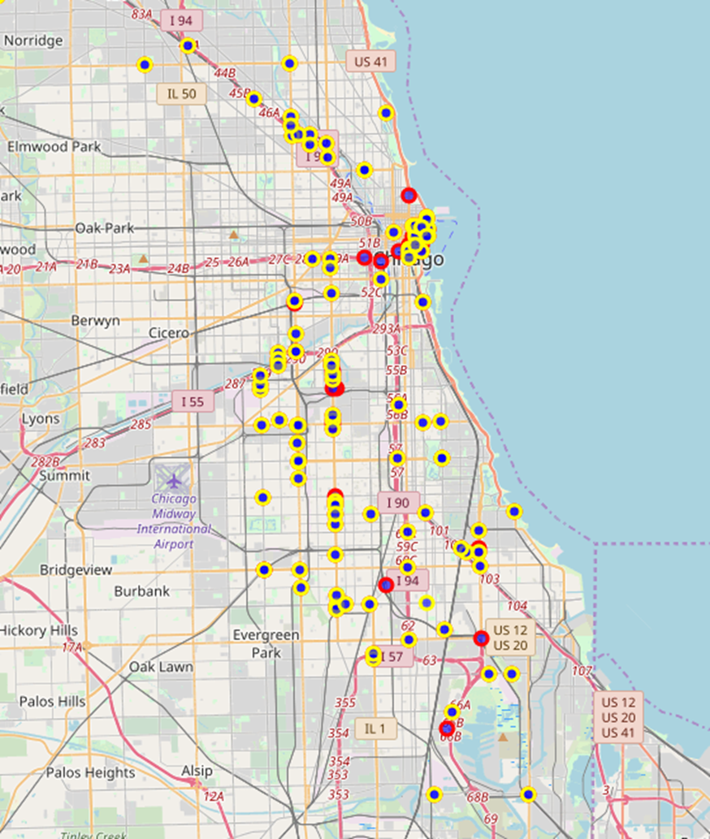
Top 20, Top 100…
No. of service requests>50
No. of service requests>30

Slide 16
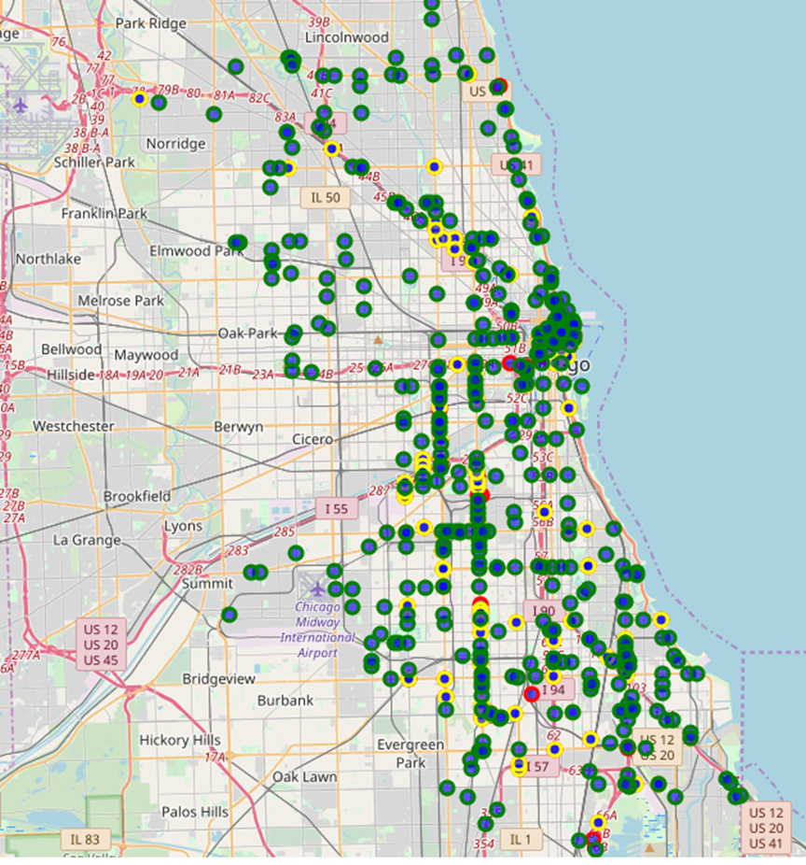
Top 500…
No. of service requests>20

Slide 17
Summary
With the analysis, we’re able to answer a set of questions and learn some information beyond just common senses
At the same time, the newly gained knowledge triggers more questions
Why there are so many potholes that aren’t fixed?
Why do they keep on coming?
Why do some potholes took so long to fix?
Why …
Why…
The information we learned helps setting directions on what other data should be collected/evaluated, depending on the application/research focus
It’s a highly iterative process, and there is gold in data!

